Slide 1

MATE ROV
Oceanus

Slide 2
Overview: Assigned Tasks
Engineering Notebook for all subteams and whole team
Weekly general and sub team meetings
General FEDC membership and Red badge
Monthly Submission of work and why these were productive:
Needs
Requirements
50 Ideas Assignment
Notes:
Reflecting over how effective were this tasks, what we need to improve, what changes we need to make, and how we will implement them

Slide 3
Overview: Timeline
May 26th
First General Meeting
July 20th
Deadline for “Requirements”
Sept. 7th
Summer Progress Presentation
June 20th
Deadline for “Needs”
August 20th
Deadline for “50 Ideas”
Notes:
From the week of 25th, subteams were expected to have weekly meetings with their peers to work on research or assigned tasks.

Slide 4
Subteam Progress & Experience

Slide 5
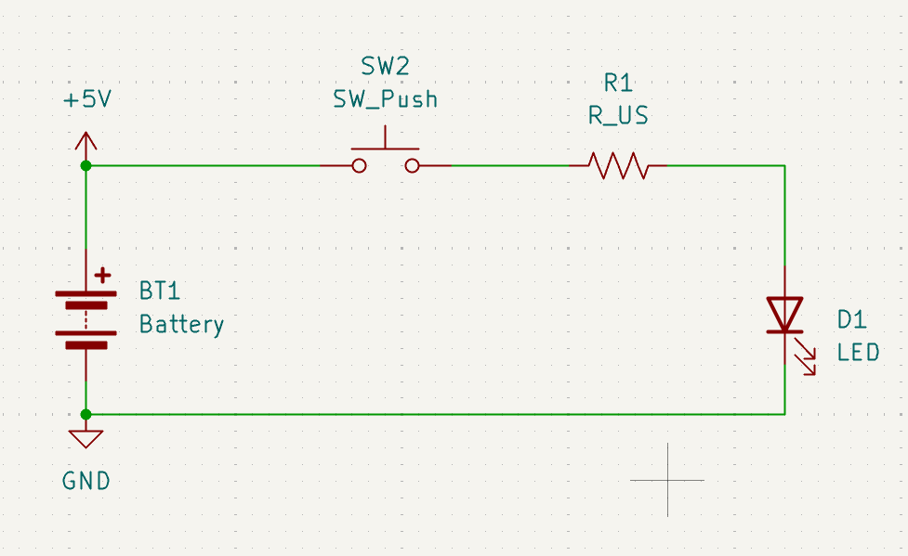
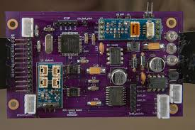
EPS: Progress
Used trade studies to select LT Spice and KiCAD
Practiced with KiCAD PCB software
Identified critical power supply data
Developed basic requirements from fundamental needs
Brainstormed 50+ potential schematics and ideas
Notes:
(top): Image of a basic KiCAD schematic for an LED circuit, created for the purpose of learning how to use KiCAD
(bottom): Image of a completed PCB used by another ROV

Slide 6
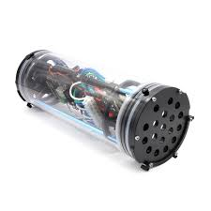
EPS: Future Plans
Narrow down voltage and power draw
Settle on a standard color coding and system architecture
Gather data on other subsystems and their requirements
Design circuit systems based on ROV system requirements
Print and develop PCBs for the ROV
Design and waterproof a housing for electronics

Slide 7

TMS: Progress
Inspected the 2025 manual
Reviewed past technical reports
Derived project requirements from needs and manual
Brainstormed 50 potential solutions to the project requirements
Solidworks certifications

Slide 8
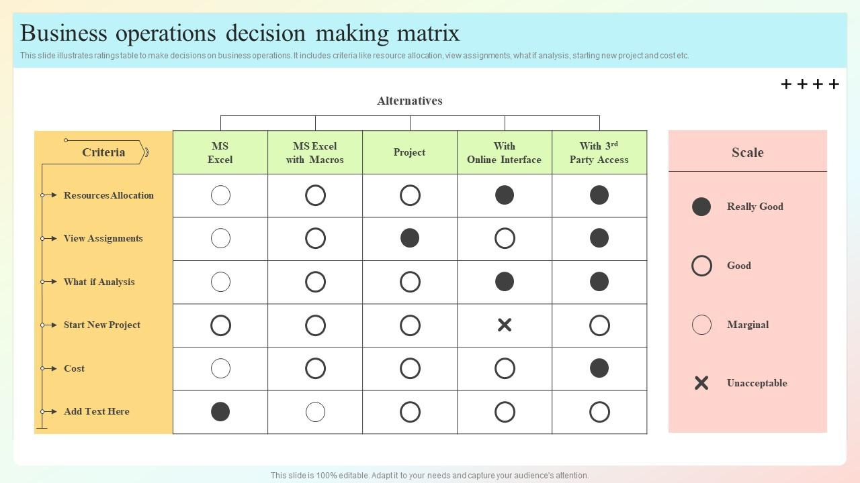
TMS: Future Plans
General/Scholarly Research
Decision Matrixes
Develop Mass/Weight Estimates
Chassis design development
Prototyping

Slide 9
C&C: Progress
You’re presenting these slides in front of people
Try not to use so many words on screen!
Instead, limit yourself to as little words as possible on the slide
Focus on speaking the most and practicing public speech
You can use speaker notes below to hide all your speaking words from the audience
Basically show how we had a productive summer
Extra things to talk about:
Mention looking at past teams when talking about the first 2 points
Go in more depth of what our roles and responsibilities are supposed to be
Gained a basic understanding of the different OS, processors, and motor controllers we could use
Researched different wiring diagram softwares for future reference
Collaborated with other subteams to better understand our roles and responsibilities

Slide 10

C&C: Future Plans
You’re presenting these slides in front of people
Try not to use so many words on screen!
Instead, limit yourself to as little words as possible on the slide
Focus on speaking the most and practicing public speech
You can use speaker notes below to hide all your speaking words from the audience
Basically show how we had a productive summer
Extra things to talk about:
Deciding what lights/camera we need to use on the ROV
Discuss how we found out that our subteam mostly works alongside other subteams so a lot of our jobs will be in collaboration with others
Work hands-on with motors and microcontrollers to build a more in-depth understanding of the ROV’s systems
Create an in-depth and easy-to-read wiring diagram for our ROV
Develop a way of connecting the ROV to the C3 station

Slide 11
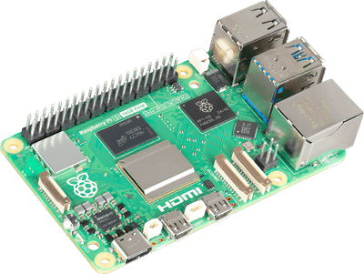
GNC: Progress
Looked through different programming environments for potential usage
Researched on potential camera systems, sensors, and types of flight controllers to be used from past technical reports
Requirements to be considered in terms of precision, motion, and control
Communicated with other subteams to better understand our role
Notes:
Software Stack
Architecture: Switched from LabVIEW to Python.
Operating System: Selected BlueOS for the main computer.
Testing: Successfully installed and tested BlueOS on a Raspberry Pi 3B.
Hardware Research
SBC: Researched Arduino, Raspberry Pi, and NVIDIA Jetson. The Raspberry Pi 4B is the top choice.
Flight Controller: The Blue Robotics Navigator is the recommended option.
Cameras: A multi-camera system (2-3 cameras) is planned for navigation and manipulation.
Sensors: Core sensors identified include an IMU, magnetometer, and pressure sensor.

Slide 12
GNC: Future Plans
Learn Blue OS. Most likely sticking to Raspberry Pi.
Decide what components should be manually controlled vs. autonomously
Work with C&C and EPS to cause motion, write logic, and coordinate electrical needs.
Be as robust as possible, give C&C a good toolbox for automation.

Slide 13

F&P: Progress
Relevant Courses:
*Solidworks 2024 Essential Training - Linkedin Learning
*Introduction To Ansys Fluent
*Mesh Generation using Ansys fluent Watertight Workflow
*Ansys Physics Setup - Ansys Youtube
*Ansys Solution Setup - Ansys Youtube
Deliverables:
F&P Subteam NB
Needs and Requirements
50 Ideas
Notes:
Solidworks 2024 Essential Training is a 9 hour course that teaches you the basics of solidworks without going into specifics like FEA or CFD
Introduction to Ansys Fluent teaches you the basics of the software

Slide 14
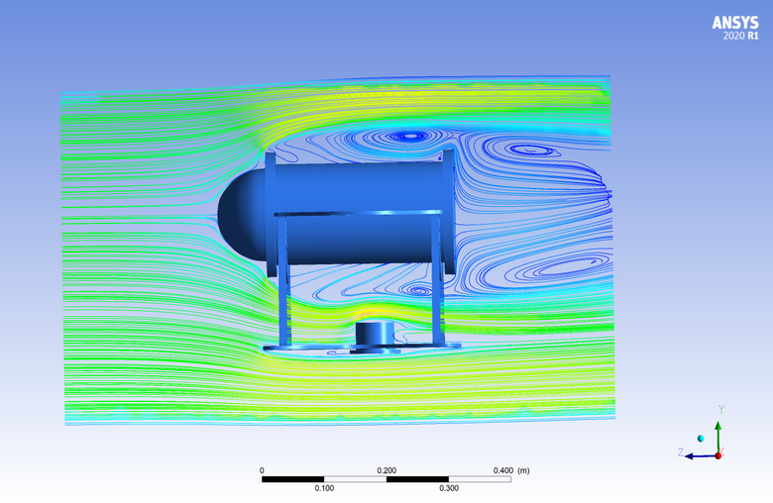
F&P: Future Plans
Monte Carlo Simulations
Solidworks File Conversion to Ansys Fluent using Ansys Workbench
Fluid Dynamics Simulations through Ansys
Basic Fluid Mechanics and Equations though Ansys Learning
Trade studies on Turbines, Brushed vs. Brushless Motors, Optimal Structural Architecture of ROV, Propellers, low power consumption design

Slide 15
Future Competition Work
Corporate Responsibility:
Outreach
Community
Other MATE ROV teams
Documentation
Open-sourced coding
Public CAD Files
Marketing:
Set up an Instagram account
Creating an identity for the team
Name ✅
Logo ✅
Merch
Financial Planning
Meet with the ThinkTank finance officers

Slide 16
Future Work: Design Phase Timeline
Trade Study for Components
Comparing changes from 2025 to 2026 guidelines
December
Registration Opens
Digital prototyping for 2025 Components
Start on Digital Prototyping for 2026 Components

Slide 17
Any Questions?

Slide 18
Appendix
Requirements
SOP (Soon…)
Summer Meetings Attendance
MATE ROV Needs & Requirements

Slide 19
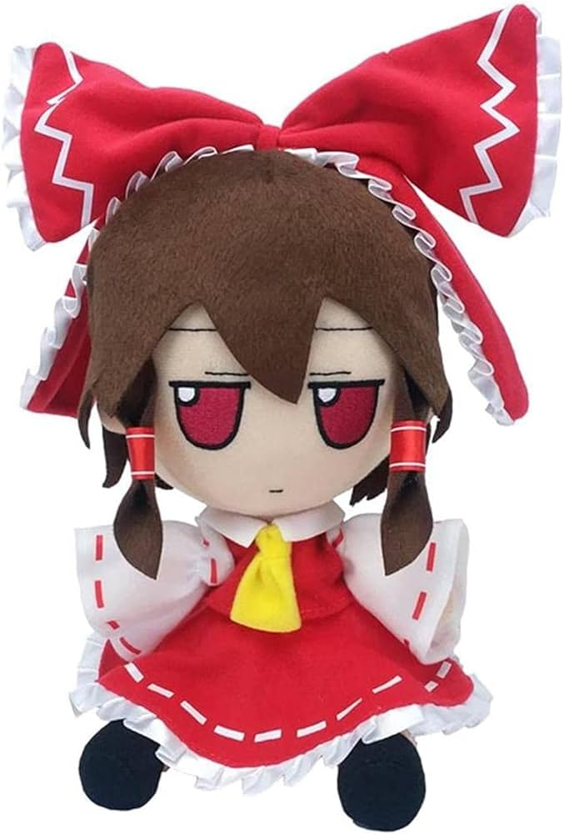
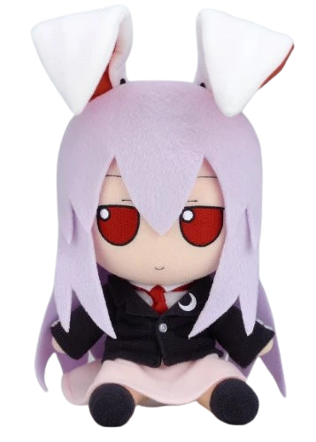
Images
IMAGES SHOULD LOOK LIKE ONE OF THE FOLLOWING
Non transparent images should have a blue outline
Transparent ones do not require an outline
Use Remove background
Notes:
template

